Slide 1
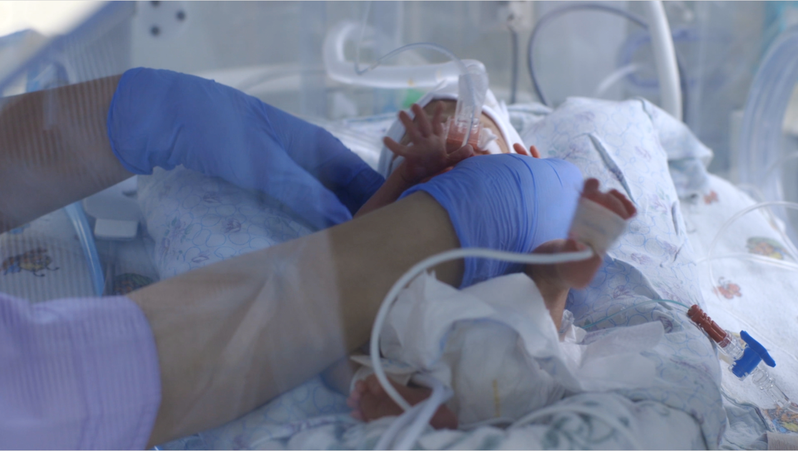
FEASIBILITY AND ACCEPTABILITY OF A NOVEL FOREHEAD-MOUNTED WIRELESS HEART RATE MONITORING DEVICE IN PRETERM BABIES
Jasmine Myhill¹, Lucy Pocock¹, Paul Clarke^{1,2}
¹ NICU, Norfolk and Norwich University Hospitals NHS Foundation Trust, Norwich, Norfolk, UK
² Norwich Medical School, University of East Anglia, Norwich, Norfolk, UK
Paul Clarke MD, FRCPH Consultant Neonatologist, Honorary Professor of the University of East Anglia Norfolk and Norwich University Hospitals NHS Foundation Trust
@drpaulclarke; @NICUNNUH1

Slide 2
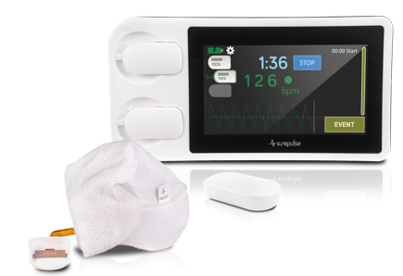
Background:
Up to 10% of newborns require enhanced support or resuscitation at birth.
Optimal management immediately after birth is critical to improve outcomes
Whilst heart rate (HR) readily indicates the baby’s response to interventions, HR monitoring via auscultation, umbilical cord palpation, ECG and pulse oximetry all have limitations in the Delivery Room
Multiple wires and sensors are often a barrier to skin-to-skin (S2S) and Kangaroo Care (KC), and KC sessions are very resource-intensive
Aim:
Our aim was to to evaluate the feasibility and acceptability of using a novel wireless HR monitor in preterm infants in the Delivery Room and the NICU
The SurePulse VS comprises a single-use thermoprotective Cap with an integrated optical sensor which, wirelessly via a module, transmits real-time pulse waveform to a display

Slide 3
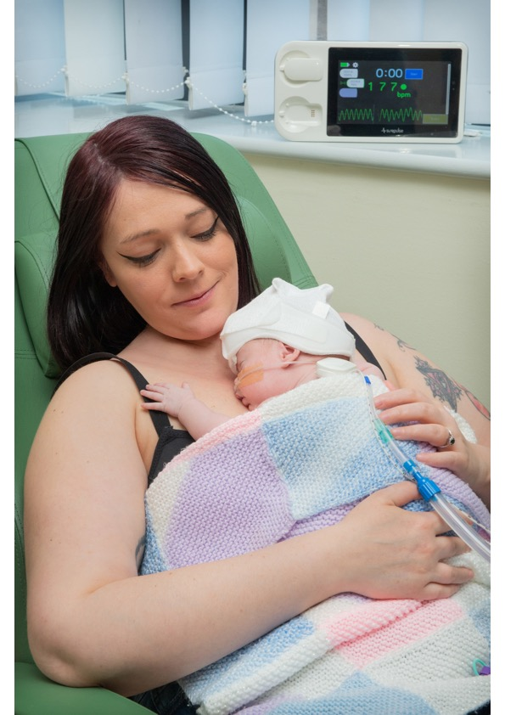
Methods:
A prospective, observational evaluation of the device in preterm infants in our centre’s NICU and Delivery Room over a 4-month period.
We used structured questionnaires to gather immediate staff feedback on the functionality and acceptability of the device for HR monitoring.
We compared real-time recorded HR data post hoc with staff perceived acquisition time and reliability of the SurePulse VS device.
Results:
31 babies underwent monitoring (10 NICU, 15 Theatre, 6 Delivery Room); Median (range) gestational age was 31⁺⁵ (24⁺⁶ to 36⁺⁶) weeks and birthweight 1715 (420 to 3055) grammes
50 user questionnaires were completed
Questionnaire reported results:
Ease of Cap fitting (86% easy or very easy);
HR signal reliability (86% all or most of the time);
HR acquisition time (48% <30 s, 72% <90 s, remaining 28% ≥120 s). In 1/29 babies a usable HR recording was not obtainable.
Recorded data supported user questionnaire feedback (25/29 babies on reported acquisition time; 26/29 babies on reported reliability).
When non-invasive respiratory equipment was deployed (n=9), 100% staff reported ‘easy’ or ‘very easy’ CPAP integration with the Cap.
With Parental permission
Conclusions:
This relatively new wireless HR monitoring approach demonstrated feasibility for use in preterm babies in our tertiary-level centre, and good staff user acceptability.
Wireless HR monitoring has the potential for assisting safe and effective monitoring by staff, while allowing parents greater autonomy during first cuddles with their babies in the Delivery Room, and during skin-to-skin and kangaroo care in the NICU.

